Slide 1
Employee Data Analysis using Excel
HEMAVARTHINI.U
312209200
B.COM BANK MANAGEMENT(BBM)
ANNA ADARSH COLLEGE FOR WOMAN
ANNA NAGAR,CHENNAI.
STUDENT NAME:
REGISTER NO:
DEPARTMENT:
COLLEGE

Slide 2
PROJECT TITLE
Employee Data Analysis using Excel

Slide 3


AGENDA
Problem Statement
Project Overview
End Users
Our Solution and Proposition
Dataset Description
Modelling Approach
Results and Discussion
Conclusion
3/21/2024 Annual Review

Slide 4

PROBLEM STATEMENT
Performance Evaluation Analysis Statement:
Analyzing employee performance data allows for objective evaluation of productivity and achievement of KPIs. This helps identify high performers, areas for improvement, and informs targeted feedback and development plans. Ultimately, it enhances decision-making and supports more effective resource allocation.

Slide 5

PROJECT OVERVIEW
Objective:
The project aims to leverage Excel's capabilities, particularly pivot tables, to analyze and gain insights from employee data. By summarizing and visualizing this data, the goal is to enhance understanding of employee distribution, performance metrics, and departmental needs.

Slide 6

WHO ARE THE END USERS?
The end users of this project are:
1. HR Managers: For managing employee performance and staffing.
2. Department Heads: To assess team performance and staffing needs.
3. Executives: For strategic decision-making and resource allocation.
4. Payroll Analysts: To ensure fair compensation practices.
5. Recruitment Teams: To identify staffing gaps and plan recruitment.

Slide 7
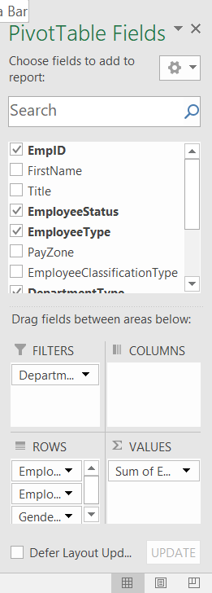

OUR SOLUTION AND ITS VALUE PROPOSITION
key features and techniques use
Filtering: Focuses on specific data subsets for detailed analysis.
Charts (Visualization): Presents data trends and patterns visually.
Reports: Generates structured summaries for consistent documentation.
Pivot Tables: Summarizes large data sets for flexible, detailed analysis.
Conditional Formatting: Highlights key data points and anomalies.
Missing Data Handling: Identifies and corrects gaps in the dataset.

Slide 8
Dataset Description
Employee Dataset - Kaggle
Total Features: 12
Features Overview:
EmpID: Unique identifier for each employee (ID)
FirstName: Employee's first name (Text)
Title: Job title of the employee (Text)
EmployeeStatus: Current status of the employee (e.g., Active, Inactive) (Text)
EmployeeType: Type of employment (e.g., Full-time, Part-time) (Text)
PayZone: Pay zone classification (Text)
EmployeeClassificationType: Classification type of the employee (Text)
DepartmentType: Type of department (Text)
Division: Organizational division (Text)
JobFunctionDescription: Description of the employee's job function (Text)
GenderCode: Gender of the employee (e.g., Male, Female) (Text)
Data Types:
ID: Numeric
Text: Categorical/String

Slide 9

THE "WOW" IN OUR SOLUTION
The unique "wow" factor in this project is the integration of real-time, dynamic dashboards created from pivot tables. These dashboards not only summarize complex employee data but also offer interactive features, such as filtering and drill-down options. This allows users to explore various aspects of employee performance, staffing, and diversity in a visually engaging and easily understandable way, making data-driven decision-making more intuitive and efficient.
3/21/2024 Annual Review
9

Slide 10
MODELLING
Modeling Summary
Data Collection:
Description: Gather employee data including identifiers, job titles, statuses, pay zones, classifications, departments, divisions, job functions, and gender codes.
Source: Provided dataset of employee information.
Data Cleaning:
Techniques Used:
Handling Missing Data: Identifying and addressing gaps or incomplete entries to ensure dataset accuracy.
Correcting Inconsistencies: Ensuring consistency in fields such as employee status, job functions, and classifications.
Purpose: Improve data reliability and accuracy for analysis.
Techniques Used:
10

Slide 11
Filtering: Focus on specific subsets of data (e.g., employees in certain departments or zones) for targeted analysis.
Pivot Tables: Summarize and aggregate data across different dimensions (e.g., department type, employee status) for detailed insights.
Charts (Visualization): Represent data trends and patterns visually to enhance understanding and communication.
Conditional Formatting: Highlight key data points and anomalies (e.g., underperforming employees, high absenteeism) for quick identification.
Data Consolidation:
Description: Combine and integrate cleaned and summarized data into comprehensive reports and dashboards.
Outcome: Provide a unified view of employee data, enabling better decision-making and strategic planning.

Slide 12
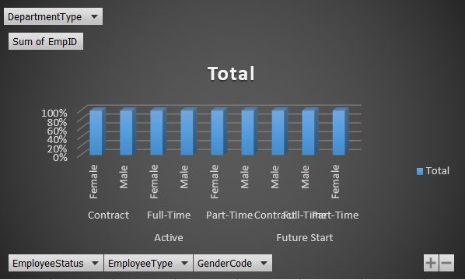
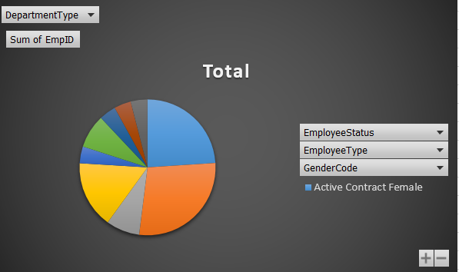
RESULTS
12

Slide 13
CONCLUSION
The employee data analysis project successfully leverages Excel’s tools and techniques to transform raw employee data into valuable insights. By meticulously collecting and cleaning data, applying advanced analytical methods such as pivot tables and conditional formatting, and presenting findings through interactive charts and reports, the project delivers a comprehensive overview of employee performance, staffing needs, and departmental trends. This detailed analysis supports better decision-making and strategic planning, enhances resource allocation, and promotes a more informed and effective management approach. The project’s outcome ensures that stakeholders can address key issues, recognize opportunities, and drive improvements across the organization.

